Slide 1
Analysis of Social Barriers, Digital Access, and Internal Bottlenecks
Immortal
Hillal Hariyono,
Hans Richard Djojosantoso,
Ryan Christopher Setiawan,
Vinson Nicholas Sorensen

Slide 2
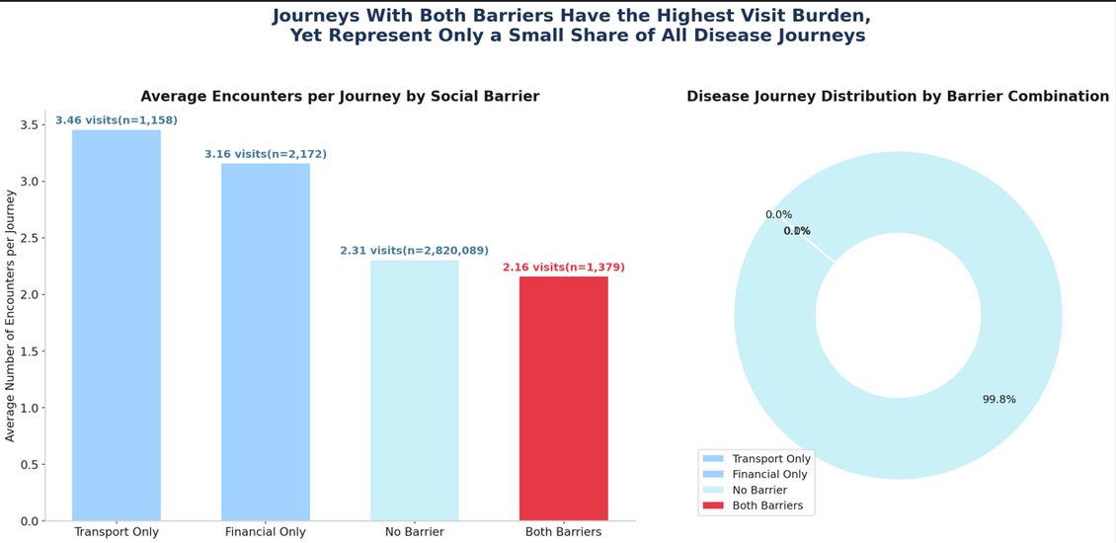
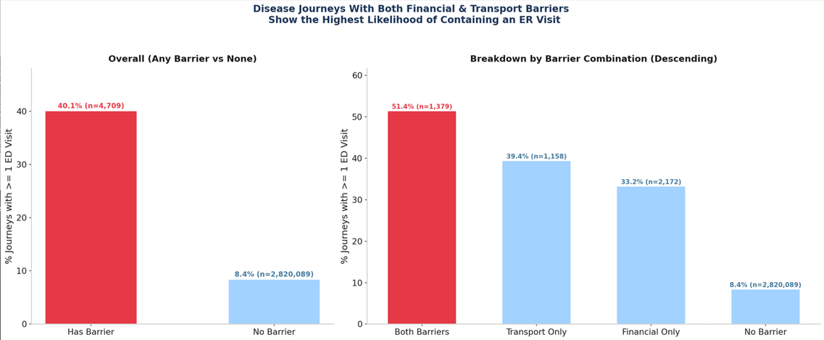
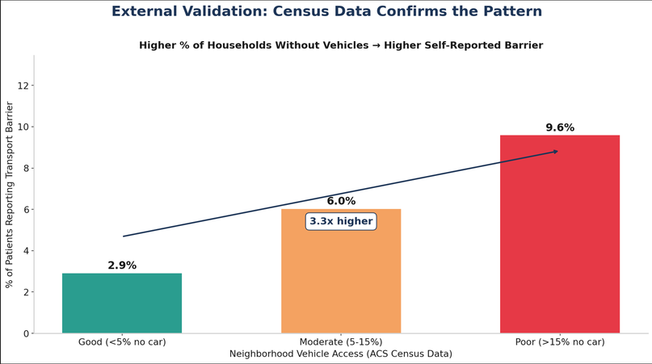
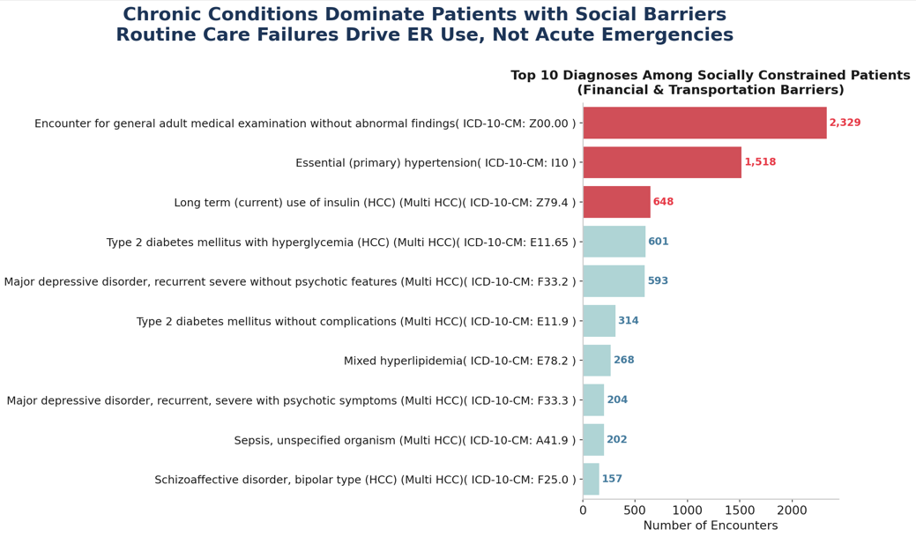
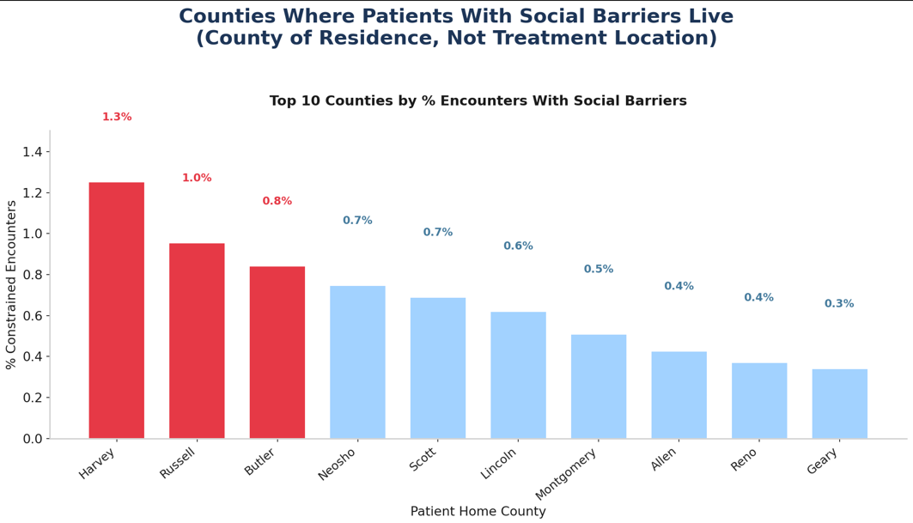

Slide 3
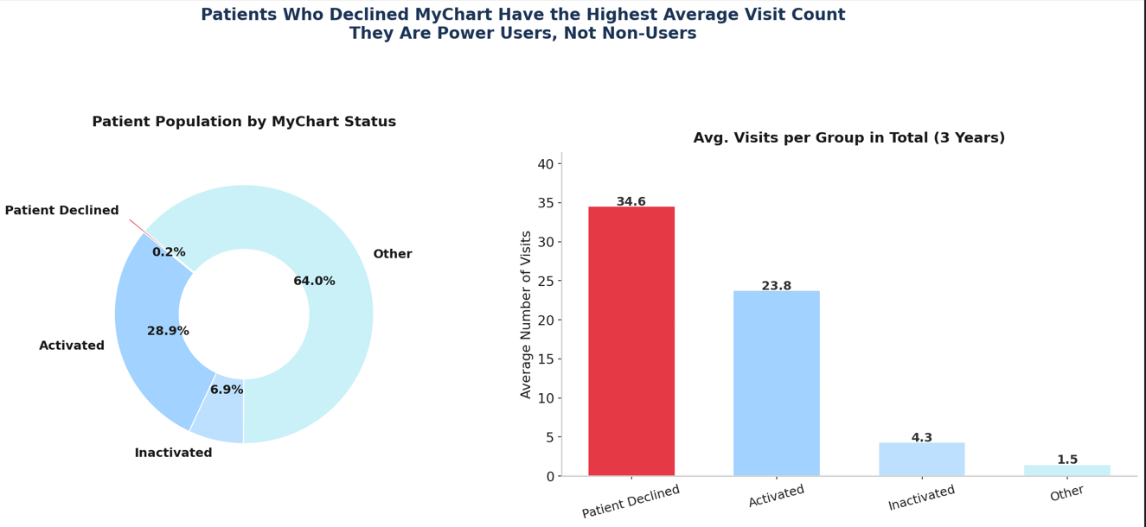
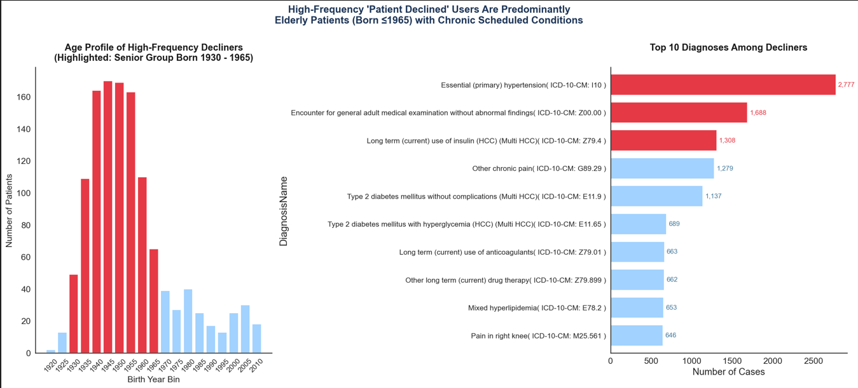

Slide 4
